Slide 1




Self-Averaging of
Digital MemComputing Machines
Yuan-Hang Zhang
D. Primosch, Y.-H. Zhang and M. Di Ventra
arXiv:2301.08787

Slide 2
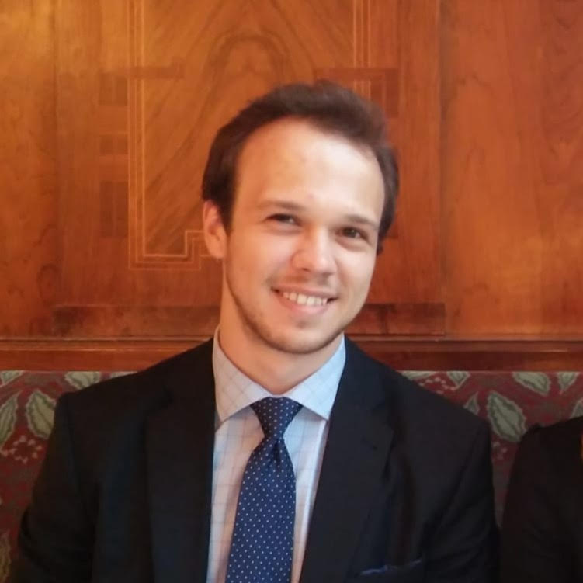
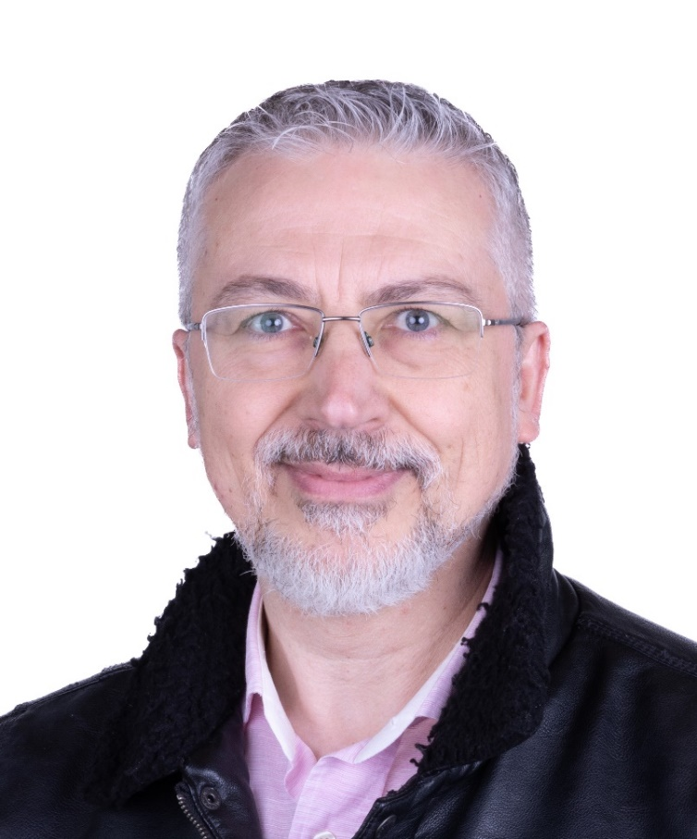
Acknowledgements
Daniel Primosch
Massimiliano Di Ventra

Slide 3
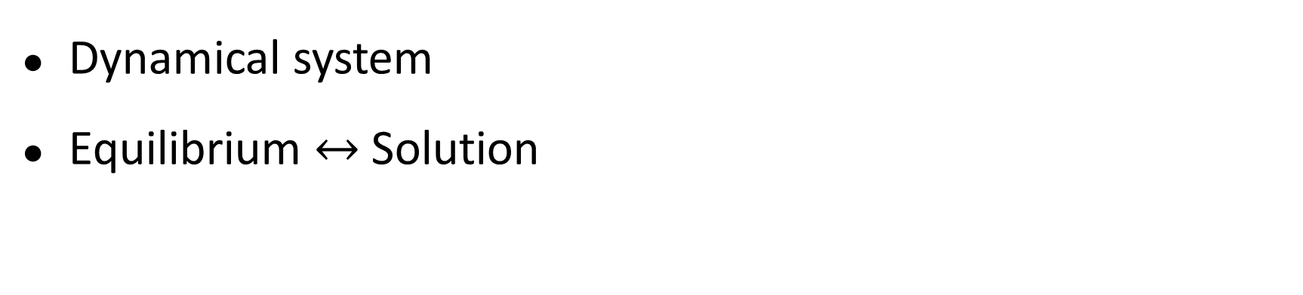

MemComputing
Computing in and with memory
Dynamical system
Equilibrium $↔$ Solution

Slide 4
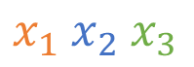
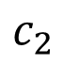
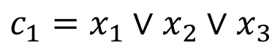
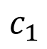

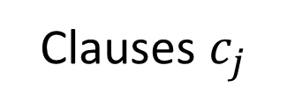
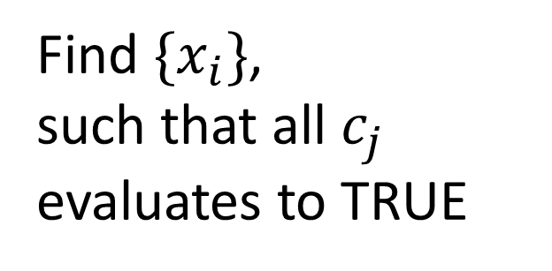

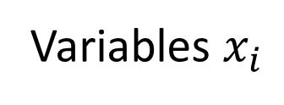

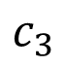
Boolean satisfiability
Variables $x_{i}$
$$x_{1} x_{2} x_{3}$$
Find $\{x_{i}\}$,
such that all $c_{j}$ evaluates to TRUE
$$x_{1}∨x_{2}∨x_{3}$$
$${¬x}_{1}∨{¬x}_{2}∨x_{3}$$
$$x_{1}∨{¬x}_{2}∨¬x_{3}$$
Clauses $c_{j}$
$$c_{1}$$
$$c_{2}$$
$$c_{3}$$
$$c_{1}=x_{1}∨x_{2}∨x_{3}$$

Slide 5
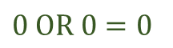
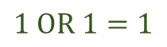
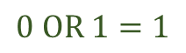
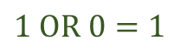
From logic to dynamics
discrete logic space
$0 OR 0=0$
$$1 OR 0=1$$
$$0 OR 1=1$$
$$1 OR 1=1$$
logic states
v₁ v₂
OR
v₃

Slide 6
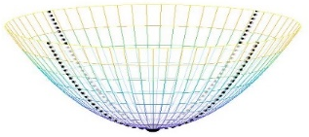

From logic to dynamics
discrete logic space
$0 OR 0=0$
continuous sub-space
$$1 OR 0=1$$
$$0 OR 1=1$$
$$1 OR 1=1$$
logic states
v₁ v₂
equilibria
OR
v₃
other local minima

Slide 7

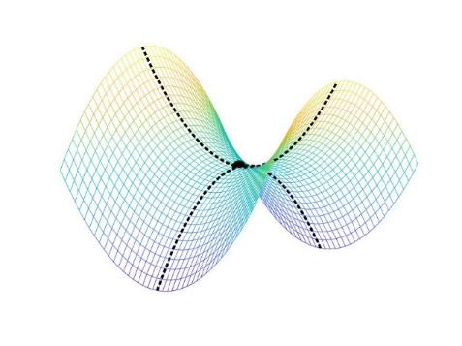

From logic to dynamics
discrete logic space
$0 OR 0=0$
continuous sub-space
$$1 OR 0=1$$
MemComputing phase space
$$0 OR 1=1$$
$$1 OR 1=1$$
logic states
v₁ v₂
equilibria
$$×$$
equilibria
OR
Additional degrees of freedom
(memory)
v₃
other local minima
saddle points

Slide 8
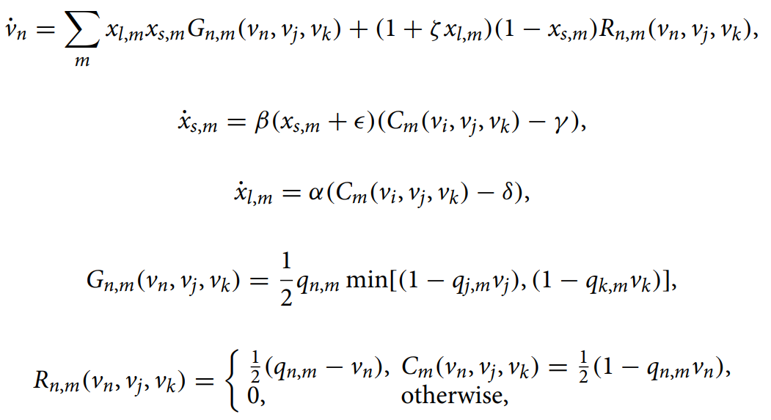
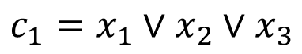
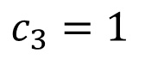
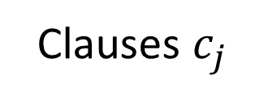
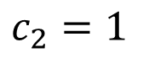
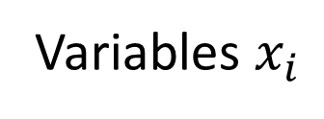
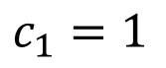
Self-organizing logic gate
Variables $x_{i}$
$$x_{1} x_{2} x_{3}$$
Clauses $c_{j}$
$$c_{1}=1$$
$$c_{2}=1$$
$$c_{3}=1$$
$$c_{1}=x_{1}∨x_{2}∨x_{3}$$
Bearden, Sean RB, Yan Ru Pei, and Massimiliano Di Ventra. "Efficient solution of Boolean satisfiability problems with digital memcomputing." Scientific reports 10.1 (2020): 1-8.

Slide 9
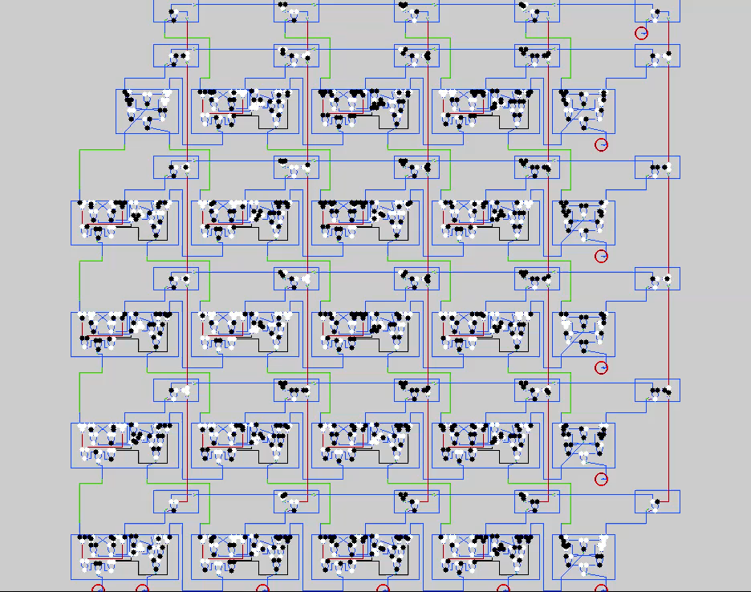
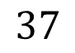
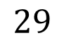


$$29×37$$
Example: $1073=$
$$29$$
$$37$$

Slide 10
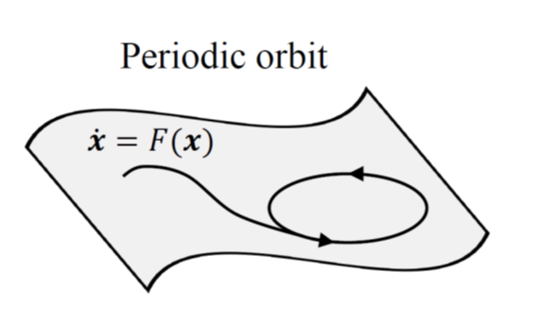


Phase space engineering
Requirements:
- Dissipative
✔
$$×$$
- Equilibrium ↔ Solution
- No local minima
- No (quasi-)periodic orbits
$$×$$
- No chaos
M. Di Ventra, MemComputing: Fundamentals and Applications. Oxford University Press, 2022

Slide 11
Phase space engineering
Requirements:
- Dissipative
- Equilibrium ↔ Solution
- No local minima
- No (quasi-)periodic orbits
- No chaos
M. Di Ventra, MemComputing: Fundamentals and Applications. Oxford University Press, 2022

Slide 12
Phase space engineering
Reality: noise
Brownian motion with drift
M. Di Ventra, MemComputing: Fundamentals and Applications. Oxford University Press, 2022

Slide 13
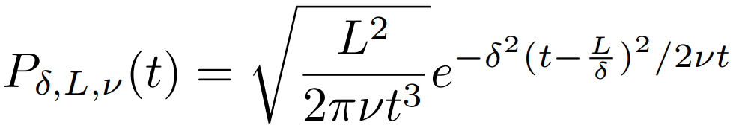
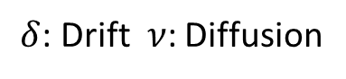
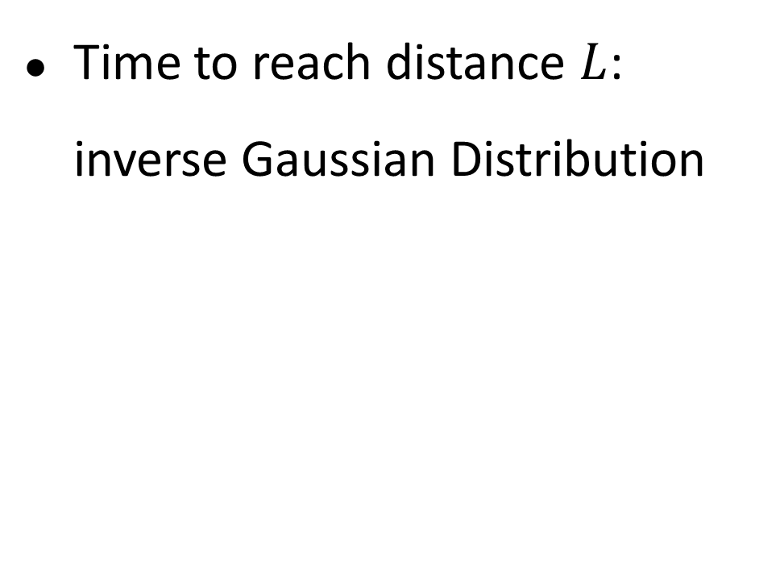
Drifted Brownian motion
Time to reach distance $L$: inverse Gaussian Distribution
$δ$: Drift $ν$: Diffusion
G. A. Whitmore and V. Seshadri, A heuristic derivation of the inverse gaussian distribution, The American Statistician 41, 280 (1987).

Slide 14
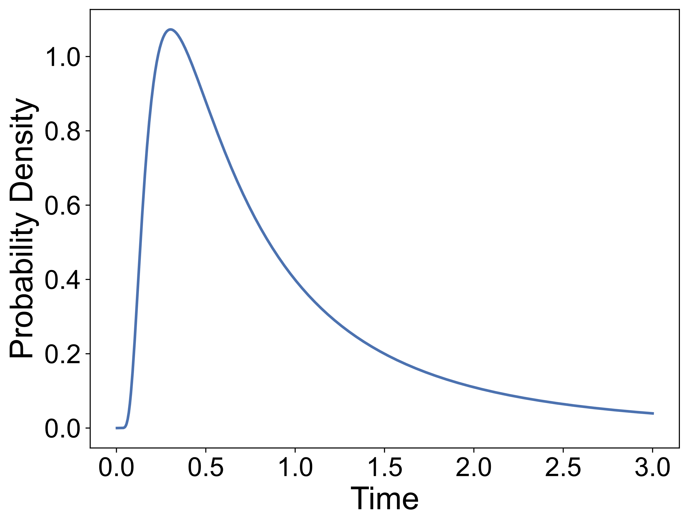
Drifted Brownian motion
Time to reach distance $L$: inverse Gaussian Distribution
$δ$: Drift $ν$: Diffusion
G. A. Whitmore and V. Seshadri, A heuristic derivation of the inverse gaussian distribution, The American Statistician 41, 280 (1987).

Slide 15
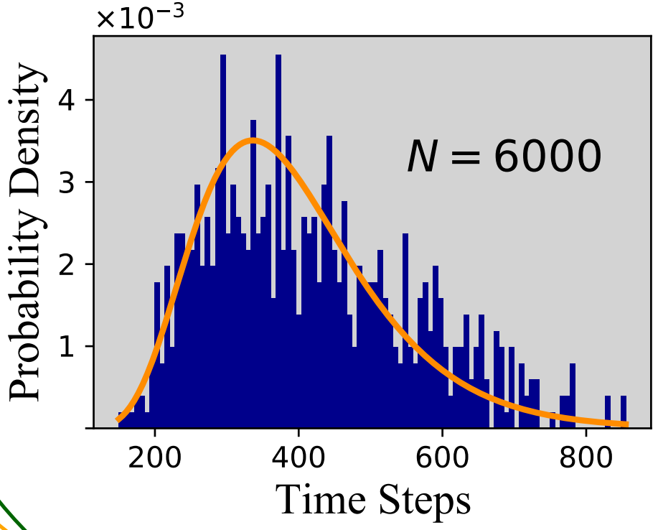
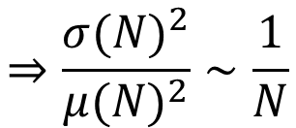
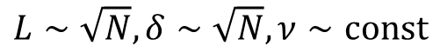
Inverse Gaussian distribution
Time to reach solution: inverse Gaussian Distribution
3SAT, clause-to-variable ratio 7
Solved with MemComputing
$δ$: Drift $ν$: Diffusion
$$L∼\sqrt{N}, δ∼\sqrt{N}, ν∼const$$
$$⇒\frac{{σ(N)}^{2}}{{μ(N)}^{2}}∼\frac{1}{N}$$
D. Primosch, Y.-H. Zhang, M. Di Ventra, Self-Averaging of Digital MemComputing Machines, arXiv:2301.08787

Slide 16
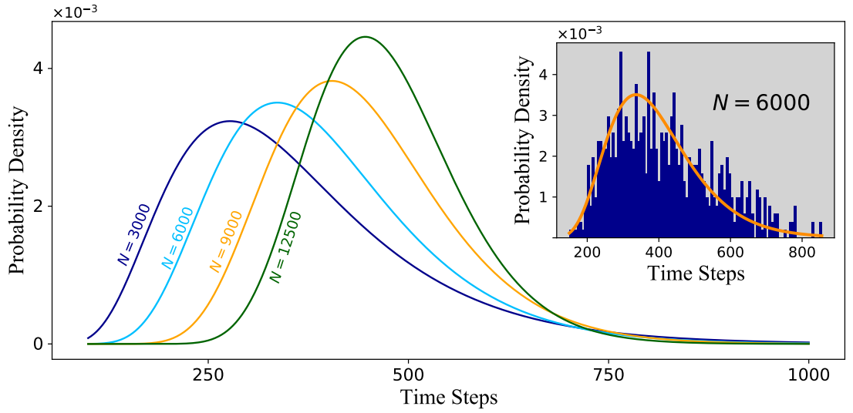
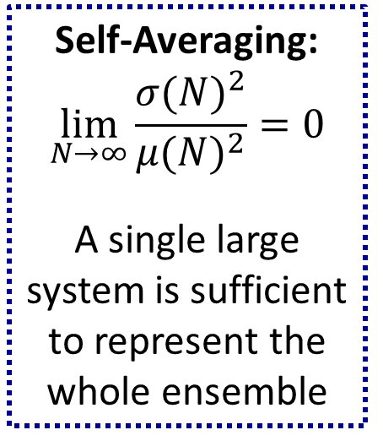
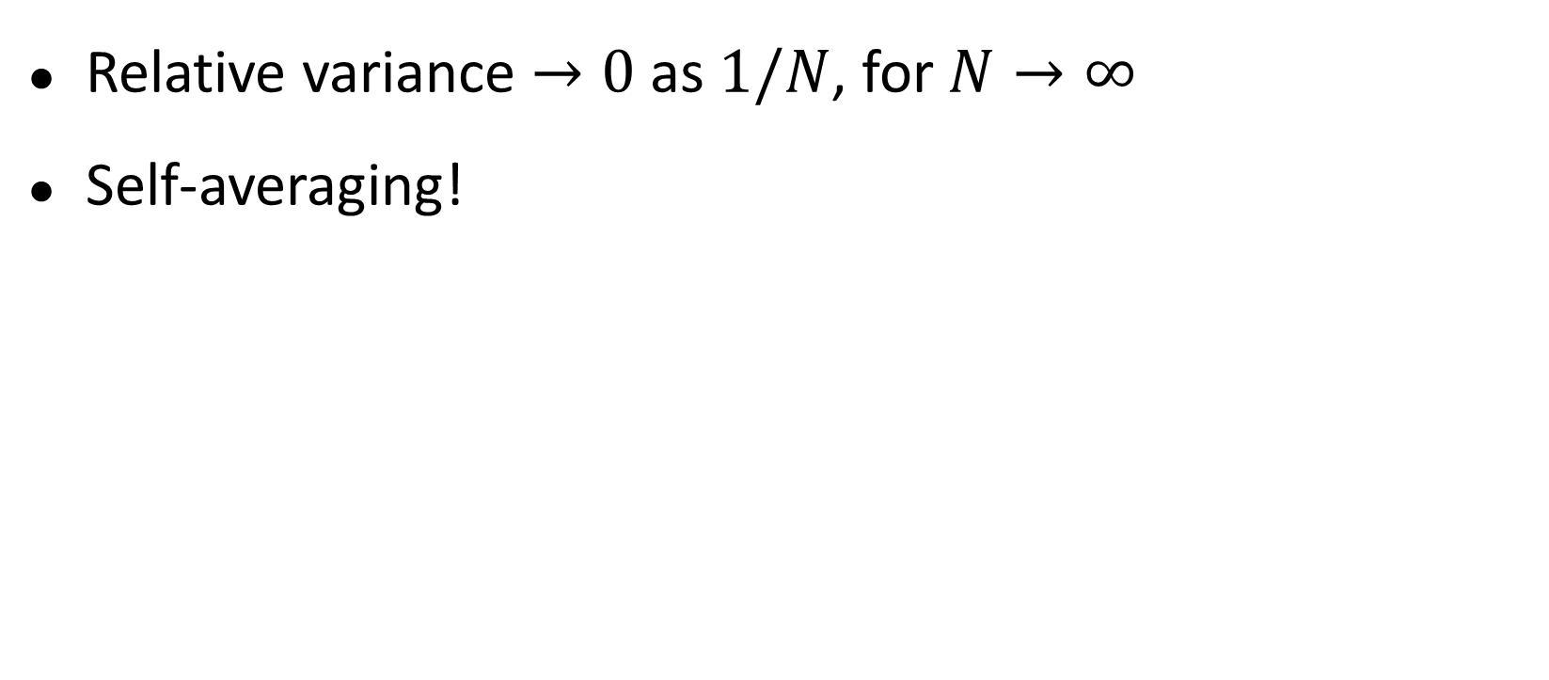
Self-Averaging of MemComputing
Relative variance $→0$ as $1/N$, for $N→∞$
Self-averaging!
Self-Averaging:
$$\lim_{N→∞}{\frac{{σ(N)}^{2}}{{μ(N)}^{2}}}=0$$
A single large system is sufficient to represent the whole ensemble

Slide 17
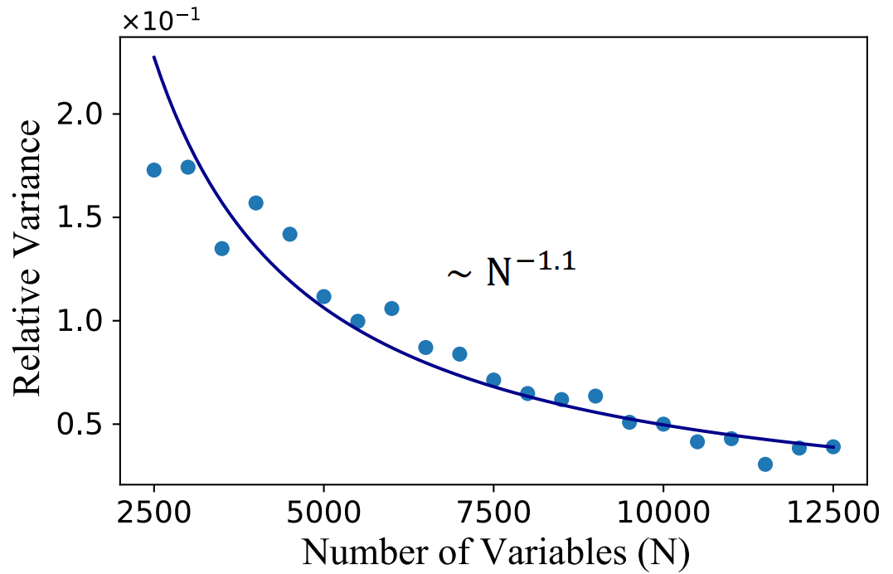
Self-Averaging of MemComputing

Slide 18
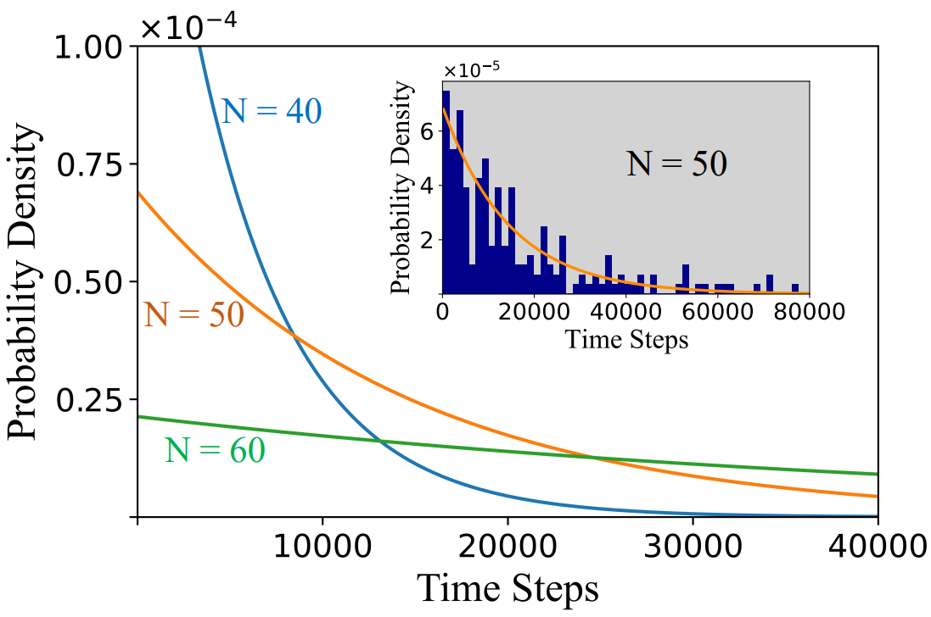
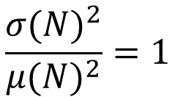
WalkSAT
$$\frac{{σ(N)}^{2}}{{μ(N)}^{2}}=1$$

Slide 19
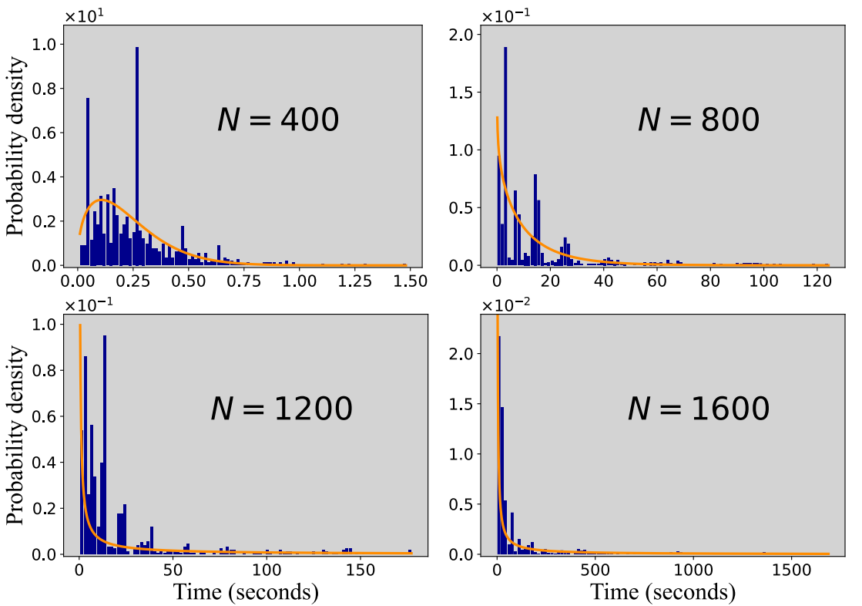
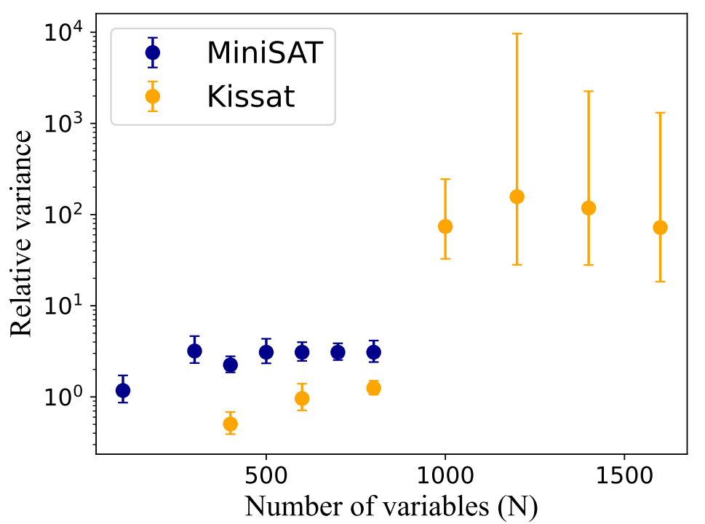
State-of-the-art CDCL solvers

Slide 20
Conclusion
Method | Time-to-solution Distribution | Self-averaging?
MemComputing | Inverse Gaussian | Yes
Traditional | Exponential-like | No
Increasingly insensitive to details!

Slide 21
Thank you!
D. Primosch, Y.-H. Zhang and M. Di Ventra
arXiv:2301.08787

